Slide 1
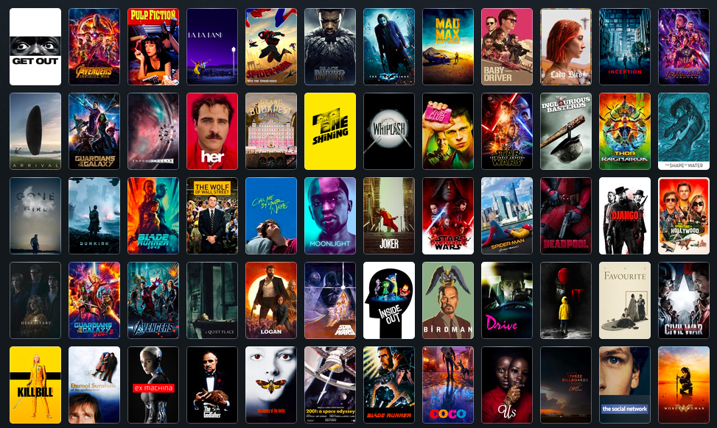
Movie Recommendation Using Naive Bayes Text Classification
Dylan McCardle | Corey Myers | Evan Sheehan

Slide 2
Project Description
Create movie recommendation engine using Naive Bayes for text classification of reviews.
Input - Prompt user for 3 liked/disliked movies, this is the start of the training/comparison set.
Algorithm - Iteratively apply different tunings of Naive Bayes
Output - A list of 1000 movies and the predicted class they belong to (like or dislike).

Slide 3
Constructing a Dataset
Dynamically loading movies to compare proved to be slow and impractical
Solution: Create a static dataset
1000 Movies
Most popular of all time according to Letterboxd.com
100 Reviews for each movie
From IMDB. Reviews more useful than Letterboxd

Slide 4
Constructing a Dataset
Selenium WebDriver to scrape 100 most helpful reviews from IMDB for each movie.
Reviews converted to dictionary with word frequency as key value.

Slide 5
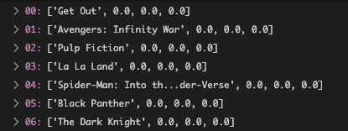
Baseline (Multinomial Naive Bayes)
Multinomial Naive Bayes
First iteration - essentially useless without Laplace smoothing/logical underflow protection
Decimals over hundreds of words will underflow to 0 and cause everything to be 0
No probabilities!

Slide 6
Laplace Smoothing Bayes
Multinomial Naive Bayes but with laplace smoothing
Smoothing helps account for the fact that not every word will appear in the training vocabulary.
Still results in nearly all zeros from computational underflow caused by the multiplication of so many very small decimals.
Still no probabilities!

Slide 7
Logarithmic Summation Bayes
Naive Bayes but in log space
We kept laplace smoothing and used log space as our way of determining probabilities to eliminate decimal underflow
At this point we also created a real world data set to begin testing accuracy
One of our group members rated all 1000 movies based on liked, disliked and not seen.
Begin to see actual results, albeit finnicky

Slide 8
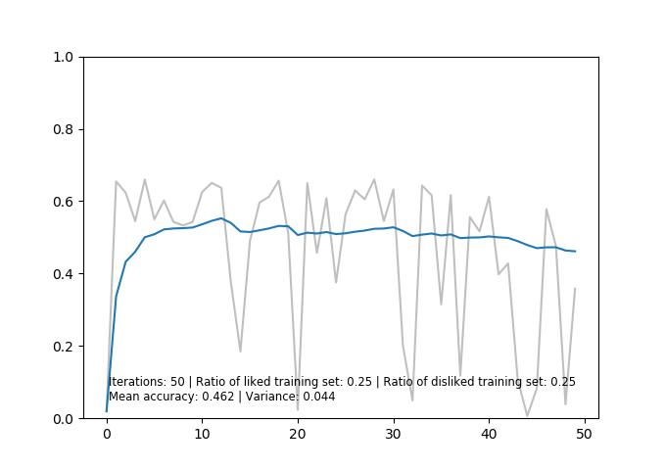
Logarithmic Bayes results

Slide 9
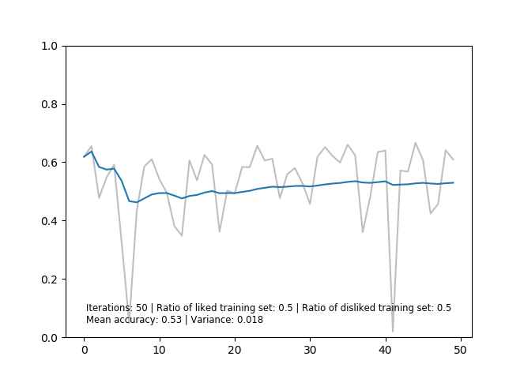
Logarithmic Bayes results

Slide 10
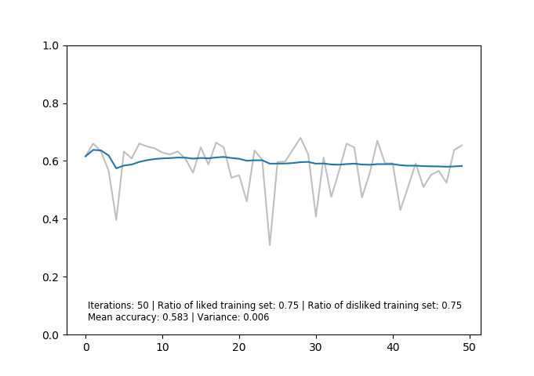
Logarithmic Bayes results

Slide 11
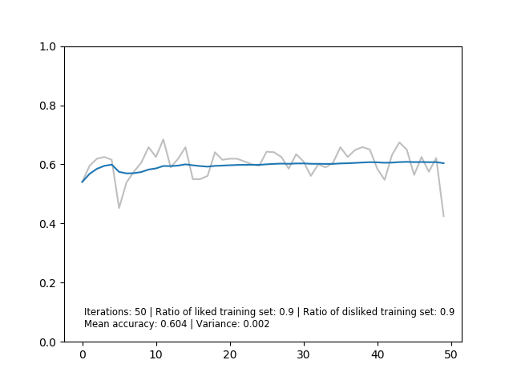
Logarithmic Bayes results

Slide 12
Other Naive Bayes considerations
Gaussian Naive Bayes
Not useful as our data set is not continuous, but instance based
Complementary Naive Bayes
Not useful as our categories are binary, therefore the complement is equal to the other category’s probability
Bernoulli Naive Bayes
Potentially useful, yet to implement

Slide 13
Adjusting Data
Outliers in data found during testing
Movies with no reviews at all
Movies with a significantly higher number of reviews/words
Movies with a significantly lower number of reviews/words
Example: The movie “Coco” with only 77 unique words in its review dictionary.
A data collection bug likely caused only a single review to be scraped.
Solution: used standard deviation of the data size to remove outlying values (very small and very large)

Slide 14
Future progressions
Plan to add more instances of data distribution by polling people to get their likes and dislikes, allowing a different training and testing set
Once we have achieved this we can compare several instances of training and testing data from several users to get a mean performance of our algorithm across several people’s preferences.
In progress - create accuracy model (based on number of runs by polling other people)
Use random 200 liked/disliked movies as basis for training vocab

